Slide 1

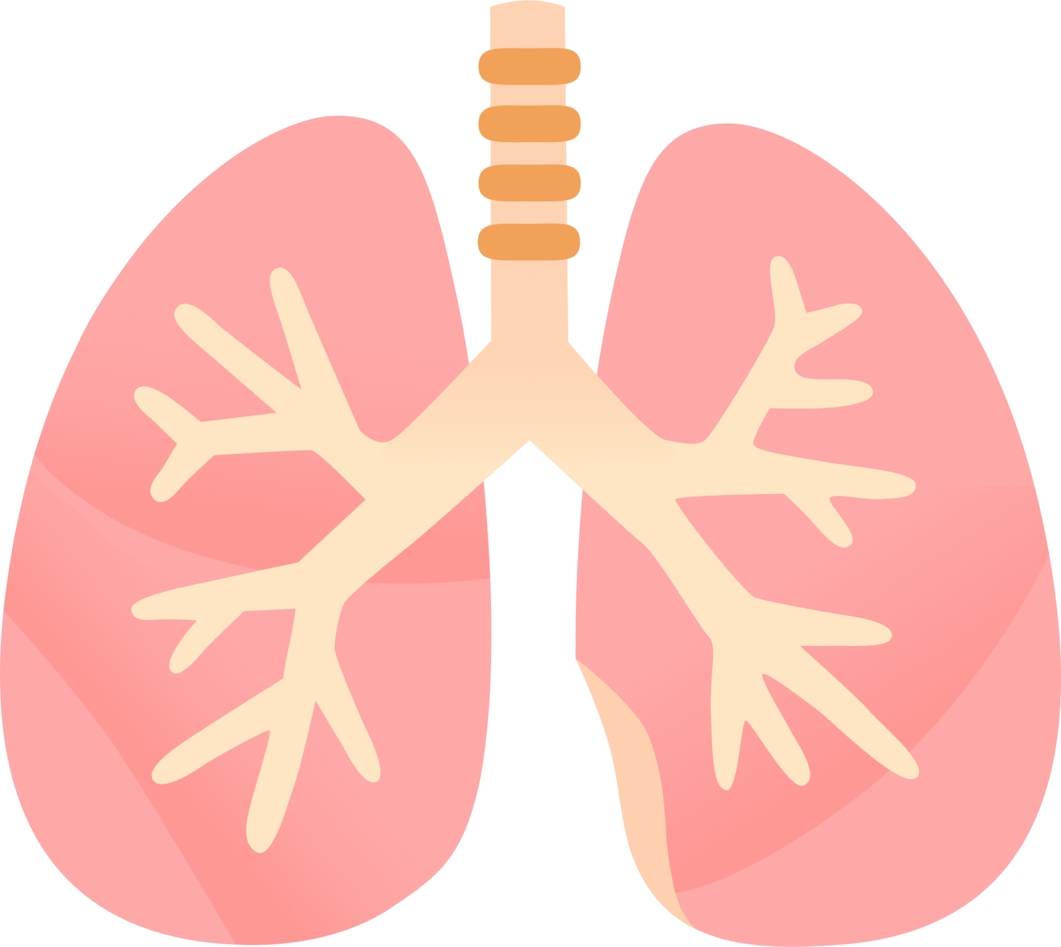
LUNG SOUND RECORDER
Team: Quad-Core Squad
By: Karthik, Aryanil, Anurag, and Adithya
Professor: Abhishek
TA: Santhoshini
Final Presentation

Slide 2
Introduction
Accurate detection and analysis of lung sounds are crucial in biomedical signal processing.
This work focuses on developing a pipeline for real-time sound analysis involving noise filtering using a band-pass filter, wavelet decomposition, and spectral gating.
It further specifies models to neatly classify data based on the recording.

Slide 3
Goal of the Project
In this project, we aim to present a comprehensive approach to lung sound detection and classification using various filtering and machine-learning techniques.
For this, we tried multiple algorithms and models and finally settled on the few that we will present today.

Slide 4
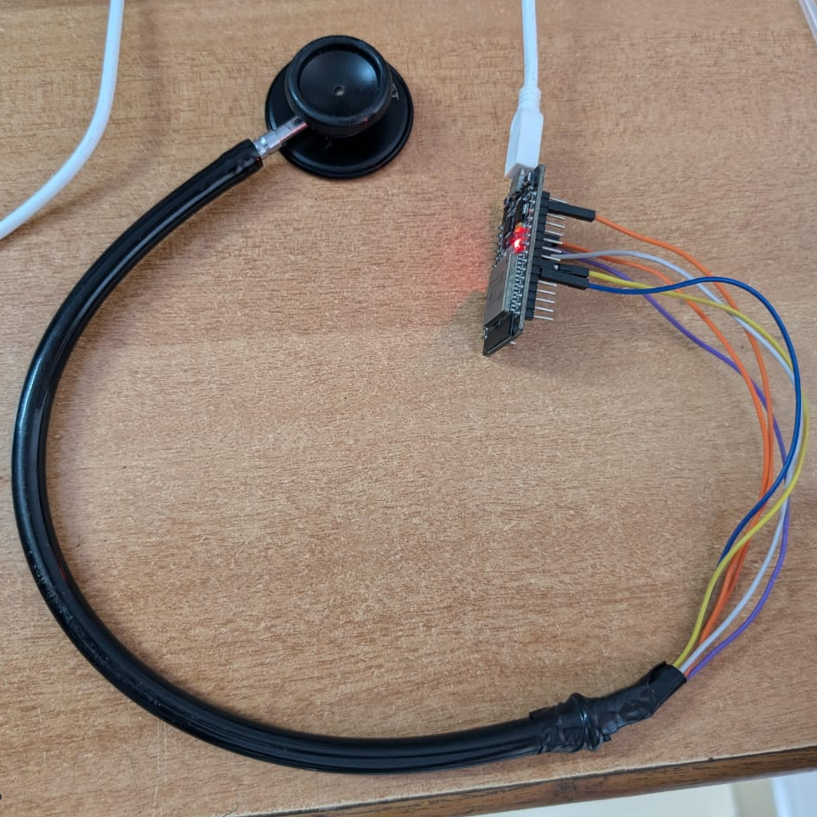
Hardware Setup
Components Used:
Stethoscope head for capturing lung sounds
INMP441 microphone sensor (digital, high SNR)
ESP32 microcontroller for data processing and transmission
Connection Details:
INMP441 connected to ESP32 via I²S interface
Stethoscope and microphone secured with electrical tape for noise isolation
Advantages:
Cost-effective, flexible, and portable setup
ESP32
Stethoscope head
Electrical tape
INMP441

Slide 5
Recording Data
Purpose:
Provides an interface for obtaining and using lung sound data
Method:
Recorded chunks of raw audio and wrote them to SPIFFS (ESP32 internal filesystem)
Features:
10-second-long recordings
Easy access to file after recording – just go to a link while the web browser is active

Slide 6
Data Transmission
Data from ESP32 had to be transported to Python
This was done via hosting a web server on the ESP32 after recording
The web server listens to any requests on the ‘/download’ endpoint
If a hit occurs, it sends the file as a response
Advantages:
Fast and reliable
Can re-send the file easily if it is somehow lost

Slide 7
Recording Process
Sound
Raw audio chunks
SPIFFS
Web server
INMP441
Onto filtration

Slide 8
Filtration Process
Purpose of Filtration:
Removes noise to enhance the clarity of lung sound signals
Focuses on isolating key frequencies associated with crackles and wheezes
Types of Filters Used:
Bandpass Filtering
Wavelet Transform Filtering
Spectral Gating
Combined Approach:
Sequential application of filters to ensure maximum noise reduction
Bandpass for frequency isolation, wavelet for transient noise, spectral gating for continuous noise

Slide 9
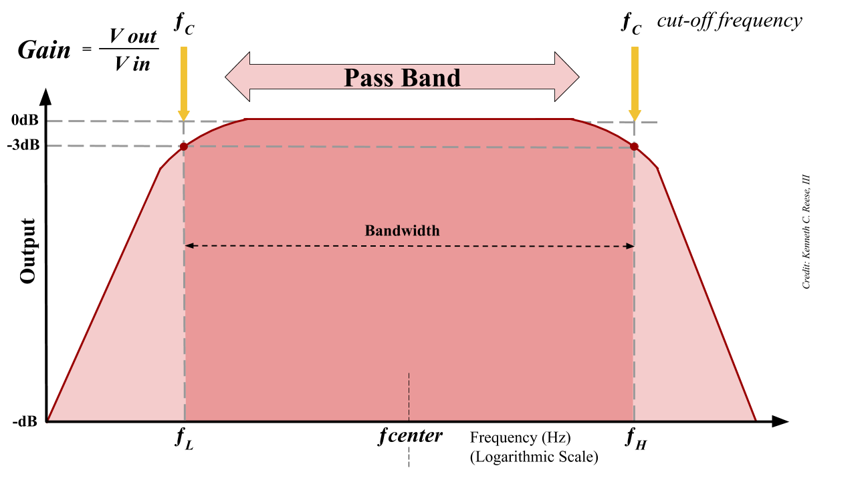
Bandpass filter
Attenuates noise outside of a certain range of frequencies
Chose a low-cut of 200 Hz and a high-cut of 1kHz
Used a 6th order Butterworth filter
Advantages:
Consistent
Simple and easy to use

Slide 10
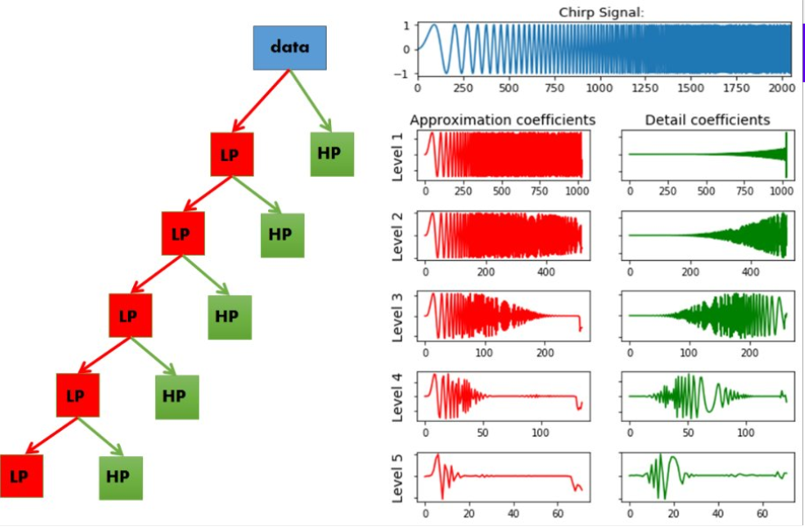
Wavelet Transform Filtering
Definition:
Allows frequencies in a specific range to pass while attenuating others
Application:
Targets frequencies between 100 Hz to 2 kHz (lung sound range)
Advantage:
Effectively removes high-frequency and low-frequency noise outside lung sound range

Slide 11
Spectral Gating
Definition:
Attenuates background noise by analyzing energy levels in different frequency bands, suppressing sounds with energy below a frequency specific threshold.
Application:
Removes low-energy noise while retaining lung sounds like crackles and wheezes
Advantage:
Effective for continuous background noise, such as room noise

Slide 12
Filtration Process
Raw audio
Wavelet Transform
Spectral Gating
Filtered audio
Bandpass filter

Slide 13

Sample Audio

Slide 14
Models
Objective:
Classify lung sounds into normal, crackles, and wheezes using AI models
Data Preprocessing:
Convert audio signals into Mel spectrograms for feature extraction
Model Overview:
Support Vector Machine (SVM) for binary classification
Convolutional Neural Network (CNN) for complex pattern recognition

Slide 15
Support Vector Machine (SVM) Model
Model Type:
Traditional machine learning algorithm for binary classification
Features Used:
Extracted from Mel spectrograms (e.g., frequency bands, energy levels)
Performance:
High accuracy for distinguishing between normal and abnormal sounds
Limitation:
Less effective for complex patterns compared to CNN

Slide 16
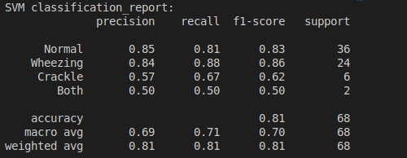
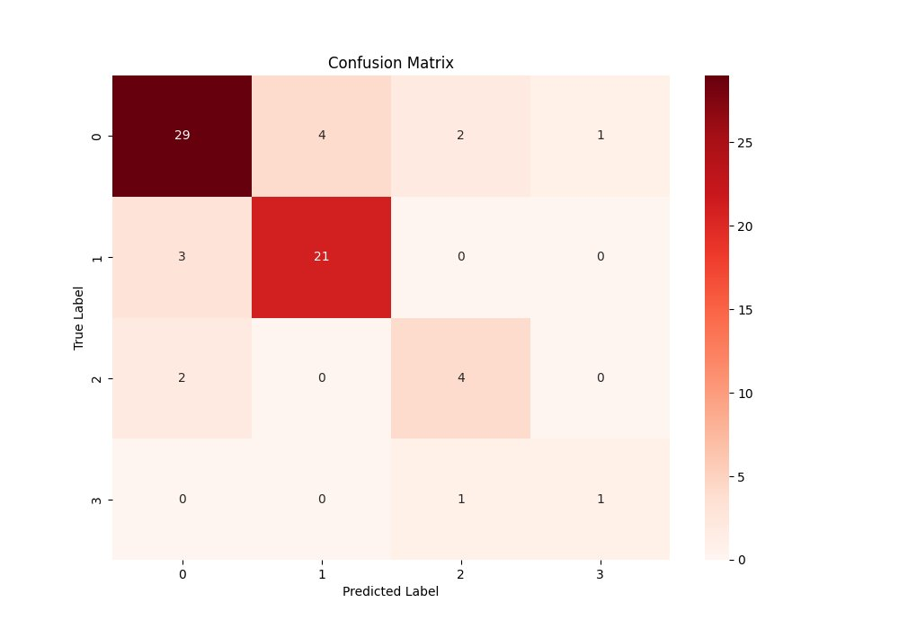
Analysis of SVM Model
We see good accuracy in recognizing normal lung sounds.
Overall, it is a balanced model that determines the quality of lung sound effectively.

Slide 17
Convolutional Neural Network (CNN) Model
Model Type:
2D Convolutional Neural Network for image-like data (Mel spectrograms).
Input:
Mel spectrogram with time frames, frequency bins, and a single channel).
Dataset used:
Fraiwan, Mohammad; Fraiwan, Luay; Khassawneh, Basheer; Ibnian, Ali (2021), “A dataset of lung sounds recorded from the chest wall using an electronic stethoscope”, Mendeley Data, V3, doi: 10.17632/jwyy9np4gv.3

Slide 18
Convolutional Neural Network (CNN) Model
Architecture:
A multi-layer architecture has been used.
The Conv2D Layers apply filters to extract features from the Mel Spectrogram
The MaxPooling2D Layers reduces the spatial dimensions while retaining the most important features.
Flatten Layer Flattens the feature maps into a 1D vector for fully connected layers.
Fully Connected (Dense) Layers learn high level features and patterns from the flattened input and produce probabilities for each of the 4 classes (Normal, Wheezing, Crackle, Both).

Slide 19
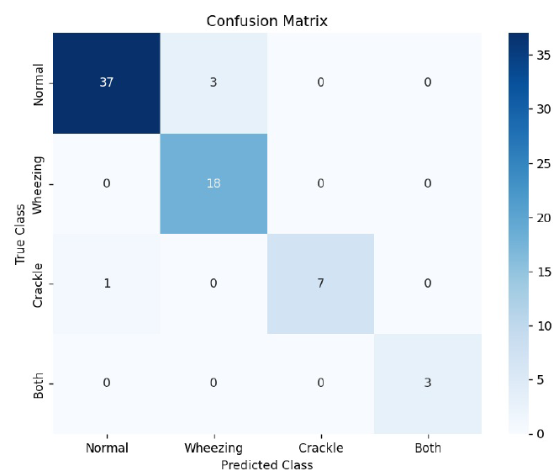
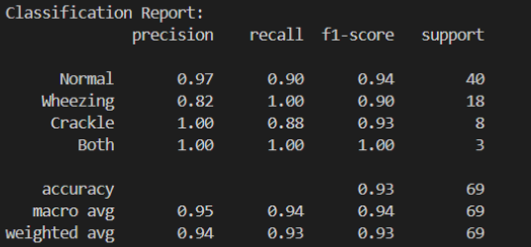
Analysis of CNN model
We observed an accuracy of 93% with the other statistics listed in the Classification Report

Slide 20
Website Application
Purpose:
Provides an interface for uploading, analyzing, and visualizing lung sound data
Features:
Real-time display of models used to predict ,analysis results and its confidence.
User-friendly interface for healthcare professionals
AI Integration:
Uses AI models to detect crackles and wheezes in uploaded audio recordings
Provides diagnostic insights based on sound classification

Slide 21
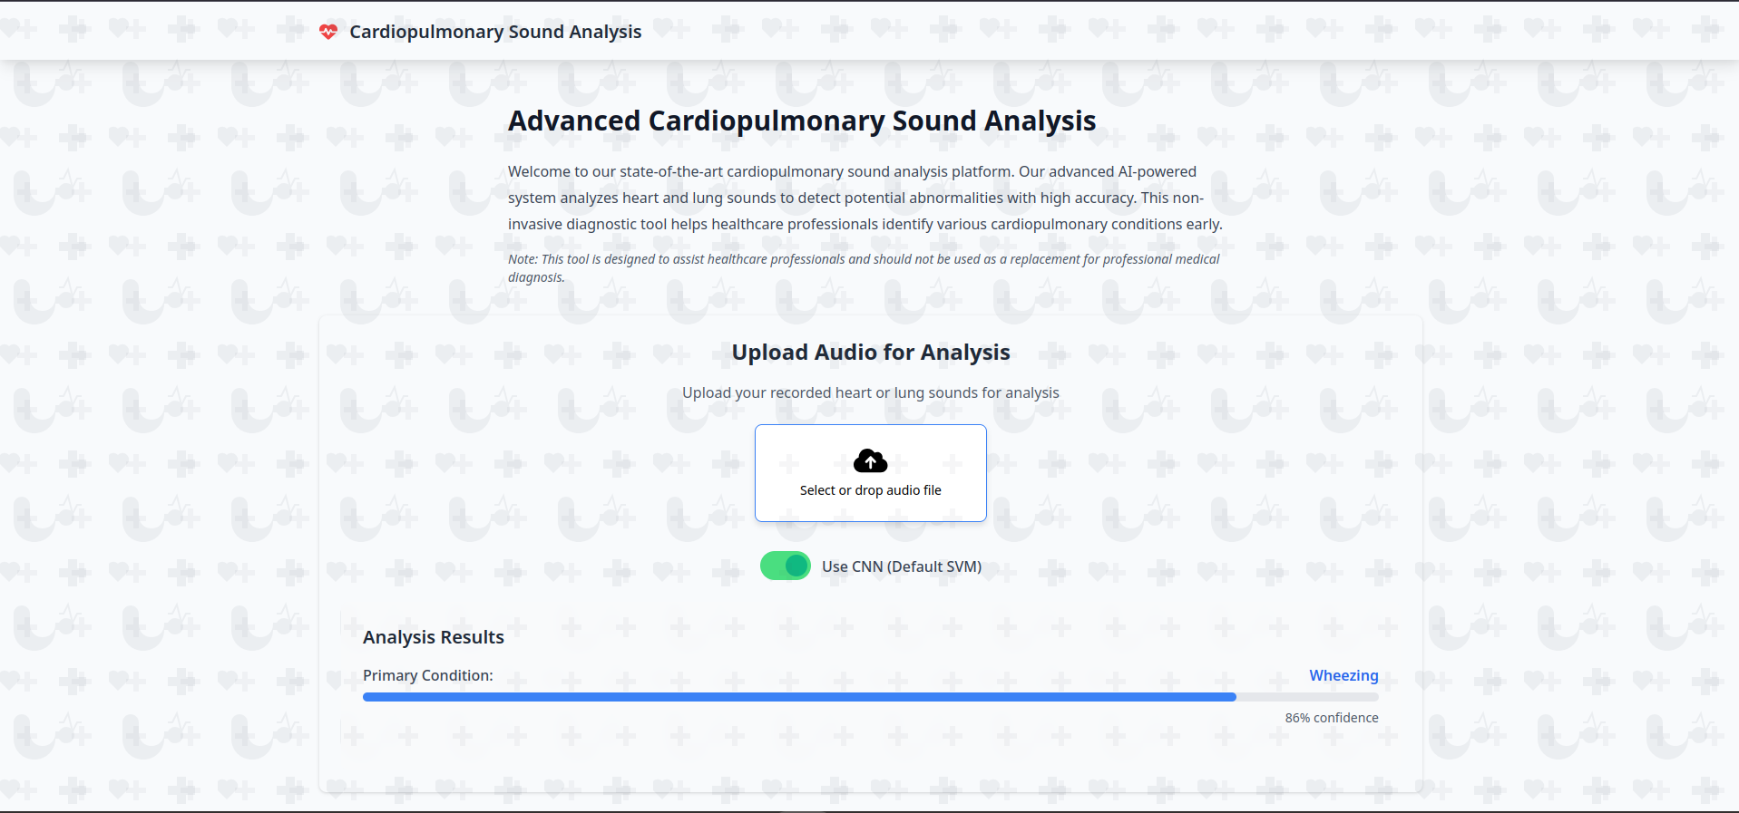

Slide 22
Flow of Execution
Recording
Pass to Python
Filtering
Sound
1
2
3
Filtered Audio
CNN or SVM
4
Website
Sends data to Model
Receives label from Model
5
6
Returns Result

Slide 23
Conclusion
Successfully developed a lung sound detection system using AI models
Hardware setup is cost-effective and efficient for real-time monitoring
Combined filtration approach ensures high-quality data input

Slide 24
Possible Future Work:
Integration with mobile apps for real-time remote diagnostics
Putting the model on edge-based devices to have easy access to classification
Expansion of AI models to detect additional lung conditions
Making a full-blown application to record, store and classify user data

Slide 25


